Slide 1
Shared Community Health Needs Assessment (CHNA)
Creating The Story About Our Data
York County
Fall 2015/Spring 2016
Notes:
Welcome/Introductions
Recognition of sponsors, organizations providing space/refreshments/other resources
Some brief housekeeping details….bathrooms, cell phones, agenda
We are here as part of the mission of the Maine Shared Health Needs Assessment & Planning Process Project, also called Maine SHNAPP. Our mission is to create the framework and approach for a shared CHNA that [a] provides valuable population health assessment data to interested organizations and individuals, [b] supports public health accreditation efforts, and [c] addresses community benefit reporting needs of hospitals.
Ultimately, the Maine SHNAPP seeks to turn data into action and create the healthiest population in the USA.

Slide 2





Maine SHNAPP Funders
Notes:
This project is supported financially and with resources by the four largest hospital systems in Maine and the Maine CDC.
Brief history -- EMHS, MG, and MH worked together in 2010-11 to create the OneMaine Health Collaborative CHNA and the Maine CDC completed the 2012 SHA.
Statewide Coordinating Council for Public Health facilitated the conversation among Maine CDC/DHHS and hospital leaders to work together on a unified health needs assessment and community engagement process – resulting in the Maine SHNAPP & Shared CHNA.
This is the 1st state-wide public private partnership of its kind in the nation.

Slide 3

Setting the Stage for Our Story
Shared CHNA data tell a story
Data interpretation
Your role in the story
Pulling it all together
Notes:
We are here today to create the story about our data. This is how we begin to turn data into action. Set the stage….
“Shared CHNA data tell a story”
Data is more useful and interesting when it relates to our lives and our community.
Local = County
“Data interpretation”
The data we are reviewing come from different places; some from an online Stakeholders Survey (May-June 2015 among about 1,600 people in Maine from over 80 organizations and businesses), some from 25 sources including surveys, health data (in-patient and office visits), and disease registries.
“Your role in the story”
Data don’t tell the entire story.
Each of you play an important role in that you experience life here and have valuable insights into the health concerns of your neighbors, co-workers, family members, etc. There are things that affect where we live, play, learn, and work that affect our health, and you know about these too.
“Pulling it all together”
The story about our data comes from discussing the Shared CHNA, getting input from experts and community members alike, and using all of this information to develop health improvement plans.
Health improvement plans – called implementation strategies by hospitals – are documents that guide the focused actions of organizations. They are similar to strategic plans for businesses or lesson plans for teachers.

Slide 4


The Script
Notes:
Provide or reference the HANDOUT of the County/District Summary Data Sheet
Previous mention of data ≠ whole story; We are using the data as a script from that we interpret based on our experiences living, working, learning, and playing in this county/district
We know things about our families, neighbors, co-workers, students, customers, and patients that provide important context for the data
This is what we are here to share today…to begin the conversation.

Slide 5

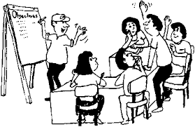


Our Task Today….
Notes:
We’ll be referring to our data summary sheets and stakeholder survey findings while we look at slides of certain health topics that affect most of us – either personally or someone we love, or through the work we do.
We’ll be looking at topics that affect a large number of us or that have significant differences between our area and the state as a whole.
Since we cannot look over all topics, we will focus on three that others have noted may be important for this county.
I’ve created a parking lot to track questions or issues we will not have time to address today. This will be shared with local leadership among a group we call the SHNAPP Community Engagement Committee (or whatever this group is called locally).
If someone has a question I cannot answer, it’ll go on the parking lot and the Maine SHNAPP Project Director will get a response. [Determine whether you as the presenter will be the go-between for questions or if you’ll share Jayne’s name and contact information to work with the person/people directly.]

Slide 6
Top health issues for York County
Stakeholder Survey – Total 1,639 surveys; York County 86 surveys
Source: Maine SHNAPP Stakeholder Survey, 2015
Notes:
We collected data from a bunch of sources, and we found that these three things were biggest health problems.
These are the top 3 health issues for York County based on information provided by the 86 respondents from this county on the Stakeholders Survey.
People who responded to the survey were asked to rank health issues on a scale of 1-5 where “1” was Not at all a problem and “5” was Critical problem. (“4” = Major problem)
The full report for the county identifies the top 5 health issues [reports are located at www.maine.gov/SHNAPP/]
The top 3 health issues for the state were:
Drug & Alcohol Abuse – 80%
Obesity – 78%
Mental Health – 71%

Slide 7
Top issues affecting where we live, work, learn & play in York County
Stakeholder Survey – Total 1,639 surveys; York County 86 surveys
Source: Maine SHNAPP Stakeholder Survey, 2015
Notes:
We collected data from a bunch of sources, and we found that these three things were the top reasons for bad health…..the top issues affecting where we live, work, learn, and play in York County based on information provided by the 86 respondents from this county on the Stakeholders Survey.
People who responded to the survey were asked to rank these issues on a scale of 1-5 where “1” was Not at all a problem and “5” was Critical problem. (“4” = Major problem)
The full report for the county identifies all of the issues [reports are located at www.maine.gov/SHNAPP/]
The top 3 factors for Maine were identified as:
Poverty – 78%
Access to Behavioral Care/Mental Health Care – 67%
Transportation – 67%

Slide 8

Quick look at data about mental health, drug & alcohol abuse, and obesity

Slide 9
Mental Health
York County
Source: Behavioral Risk Factor Surveillance System (BRFSS), 2013
Notes:
This graph shows the percentage of current anxiety and depression among adults…
This shows the percentage of adults who have ever had anxiety (19% in York County and 19% in Maine). The percentages are the same for county & state.
And the percentage of adults who have ever had depression (22% in York County and 24% in Maine) – slightly lower in York County than in Maine.
These data are from 2013.

Slide 10
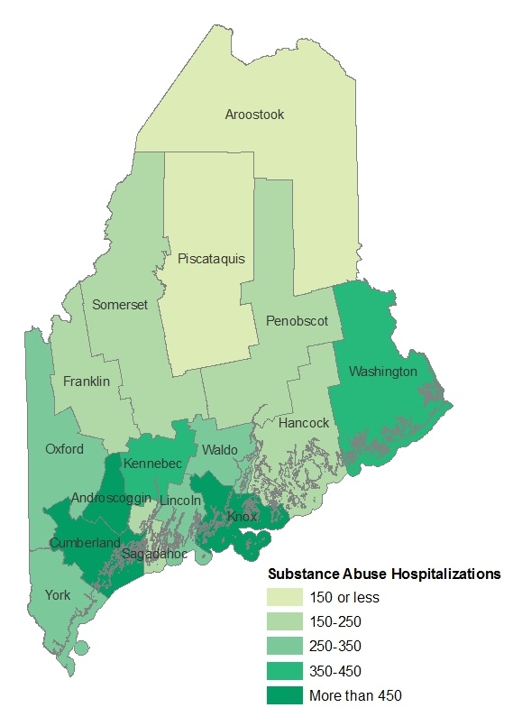
Drug & Alcohol Abuse
York County
Substance Abuse Hospitalizations by County
York
316 per 100,000
Maine
328 per 100,000
Per 100,000 population
Maine Shared Health Needs Assessment, 2015
Source: Maine Health Data Organization, 2011
Notes:
This map shows how all counties in Maine compare to each other on the # of hospital admissions for substance abuse.
York County is slightly lower than Maine at 316 vs 328 per 100,000 population; This is not measured at the national level.
Androscoggin, Cumberland and Knox Counties have the highest rates of SA hospital admissions.
Data is from 2011.

Slide 11
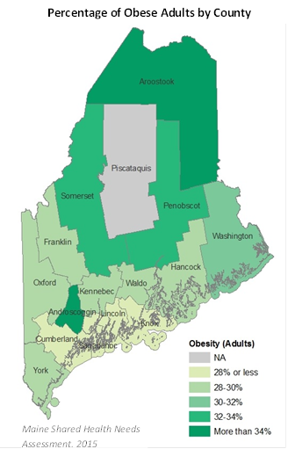
Obesity
York County
York
28%
Maine
29%
Source: Behavioral Risk Factor Surveillance System (BRFSS), 2013
Notes:
This map shows how all counties in Maine compare to each other on the % of obese adults.
The data were not included for Piscataquis because the numbers of people answering this question were too low. Because of this issue with small numbers we’re working to expand the sample size in 2016.
York County is slightly lower than the Maine percentage (and nationally @ 30%).
The darker green shows higher percentages of obesity among adults.
These data are from 2013.
Obesity defined via BRFSS U.S. Core – people self-report their height and weight which is used to calculate BMI those above 30 are considered obese.

Slide 12

2 Minute Data Review
Notes:
Please take 2 minutes to look over your handout: Summary Data for York County.
You’ll notice the column for our county, Maine, and USA to show comparisons. Numbers in the county column that are highlighted and italicized are statistically significant, meaning the difference did not happen by chance. But also notice numbers that are higher or lower than the state and look at the trend arrows to see how things are changing over time.
Presenter [or someone identified as timekeeper] should watch time.

Slide 13

Creating The Story About Our Data
Significant health issues
Health priorities
Resources to address health issues
Perceptions about things where we live, work, learn, and play that affect our health
Notes:
Edit this slide to include bullets for only the 1-2 questions you’ll have time to ask this group. It may be helpful to write their responses on paper posted to the wall.
Acknowledge the limited time and place items/questions for further discussion in the parking lot. Let group members know the parking lot will be shared with the local SHNAPP Community Engagement Committee contacts (listed on the next slide). Encourage motivated community members to seek these people out for further discussion….segue to next slide
Ideas for questions:
-We’ve looked briefly at data for our county. Based on your experience living here and quickly looking over these numbers, what would you say are significant health needs for our community?
-What would you say are the highest priorities among health needs for this county (or community)?
-What resources or assets are you aware of locally that could address our health needs?
-What do you think are the reasons for some of the poor health outcomes (name issues or priorities noted by this group as examples)? If the group needs prompting, remind them of the Stakeholders Survey issues: Transportation, Health Care Insurance, Health Literacy. [Contact Jayne Harper for a full list of the health factors affecting where we live, work, learn, and play that were included in the Stakeholders Survey.]

Slide 14
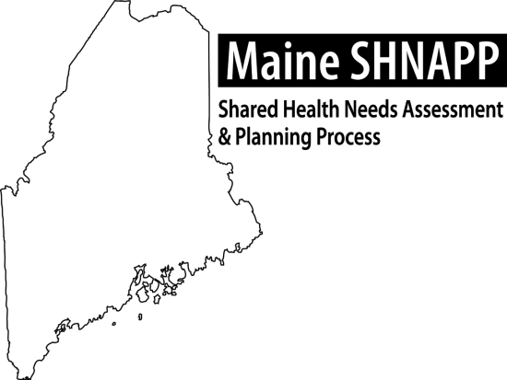
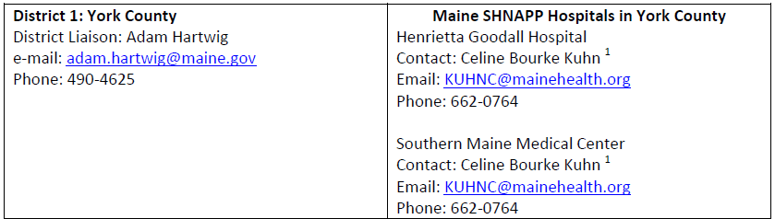
I’d like to continue the conversation about the
Shared CHNA…..
Maine Shared Health Needs Assessment & Planning Process Contacts for Community Engagement – District Liaisons & SHNAPP Hospitals
Shared CHNA Reports: www.maine.gov/SHNAPP/
Notes:
Add local contacts
Recommendation – print this slide as a Handout for participants
Remind participants they can provide input & feedback at the website listed here. All comments are welcome.

